Slide 1

Bigfish Department Work Procedure
Donald Samson, June 27, 2013

Slide 2
Objectives
To help improve the working procedures in Bigfish Department.
To ensure the quality of our work and to deliver our clients with satisfactory web services.
To create a systematic and well organized working environment with excellence-oriented objectives.

Slide 3
The Incidents
We are having hard time in handling clients‘ task when the Project Manager is not present.
There are clients who send their payments late.
Before, there were undelegated tasks resulting to delay in sending updates. We are not properly guided.

Slide 4
The Problems
Unfinished and delayed tasks resulted to unsatisfied clients and some had almost hit the roof that time it happened.
Un-equal distribution of workloads happens when a Project Manager is absent or on-leave.
Having no proper procedure is not systematic resulting to slow and unefficient production.

Slide 5
Old Procedures
Turn-over of tasks are not done properly. We do it via phone calls or messaging.
We have different ways and schedule of reminding our clients for their payment.
We are not guided by documented procedures and processes that’s why we always ask questions.

Slide 6
Procedure 1: Sending Leave Notice to BF
I. Holiday Leave
The Bigfish Coordinator should list down all legal holidays in Philippines for the current year. Check bulletin board.
If there is an upcoming holiday he must inform Project Managers to give their clients notice 3 days before the holiday.
The Bigfish Coordinator will create a template letter for the specific holiday.
Project Managers will send the letter to all clients through email or any medium of communication the clients prefer.

Slide 7
Procedure 1: Sending Leave Notice to BF
II. Vacation Leave (PM who is on vacation)
Send an email to client 3 days before the actual vacation leave.
Team Leader may set a meeting for the proper turn over of tasks and projects.
Check all tasks if properly assigned. Workloads must be delegated equally to prevent delay in production.

Slide 8
Procedure 1: Sending Leave Notice to BF
III. Sick Leave (PM who is sick)
The Team Leader should call the PM who's handling specific BF.
Team Leader may set a meeting for the proper turn over of tasks and projects.
Check tasks if properly assigned. Workloads must be delegated equally to prevent delay of tasks.

Slide 9
Procedure 2: Sending Invoice to Client
Payment Schedules
If Weekly,
Inform the BF 2 days before the payment before the end of the week.
Send the invoice through skype chat and email letter
If 15/30,
Inform the BF 3 days before the payment before the 15th and 30th day of the Month.
Send the invoice through skype chat and email letter

Slide 10
Procedure 2: Sending Invoice to Client
if Monthly,
Inform the BF 3 days before the payment before the 30th of t he Month.
Send the invoice through skype chat and email letter
if Per Project,
Compute total hours
Send the invoice through skype chat and email letter

Slide 11
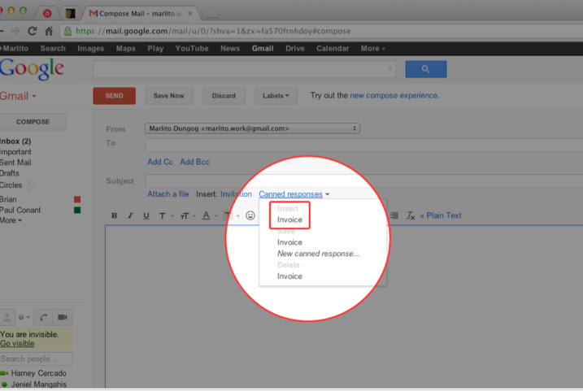
Procedure 2: Sending Invoice to Client
Sending the Form
In respective Gmail Accounts you are using (Harney, Marlito, Tristan and Marvin) there is already a saved template for the Invoice. Under the subject field, click Canned Responses, and then select “invoice” under “insert”. Be cautious not to select the other one.

Slide 12
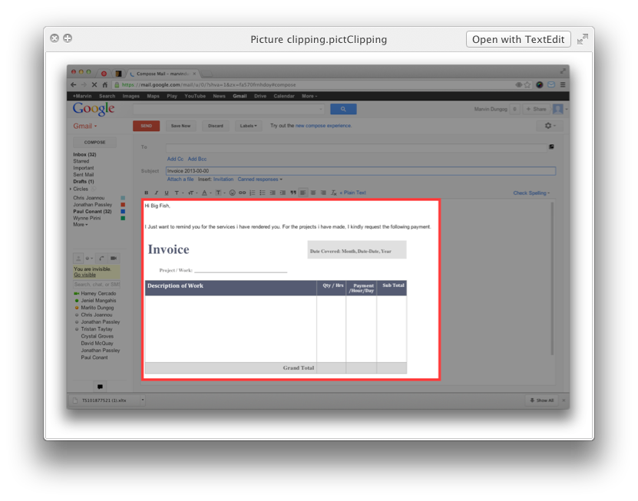
Procedure 2: Sending Invoice to Client
B. After Clicking “Invoice” , a template will automatically appear.

Slide 13
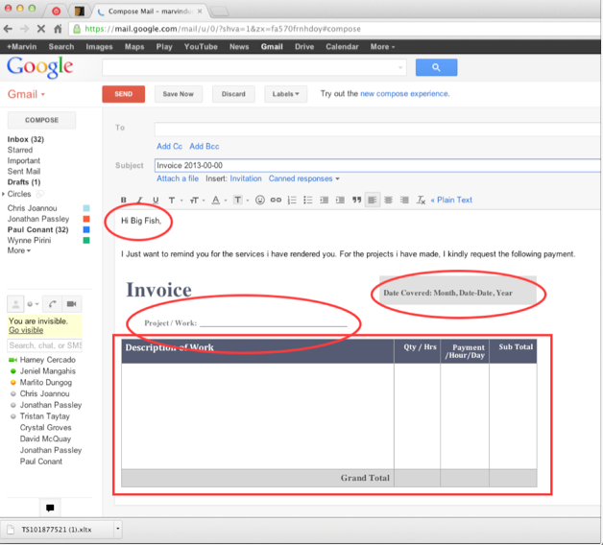
Procedure 2: Sending Invoice to Client
C. Don’t forget to input / change the required fields.

Slide 14
Project managers’ Daily Tasks
I. Pre-Production
Check your emails. After cleaning your area/table, first thing to do is to open your personal email and check everything, as it is the medium of communication in sending announcements and information.
Open the PM’s email account.
Check all the tasks that clients are sending you. Note all the tasks and categorize them from the most urgent to the least urgent. In this manner you can maximize your time and help the production easier and faster.

Slide 15
Project managers’ Daily Tasks
If you don’t now the login credentials of the account you are using, open the keepass application­­ and look for the login information of the account. Here are the complete lists of the accounts the company is using:
Harney Cercado
Marvin Dungog
Marlito Dungog
Tristan Taytay
Jeniel Mangahis

Slide 16
Project managers’ Daily Tasks
II. Production
The Project Management Application.
After listing down all the tasks, open the Project management Web Application: http://gleent.apps/scrum .
Assign the tasks accordingly. All Design tasks must be delegated to Creative Team Leader. All conversion tasks to the Front-End Developer Team Leader. And all programming tasks to the Software Engineer Team Leader.

Slide 17
Project managers’ Daily Tasks
Check all the tasks delegated to you. After assigning all the tasks, open you account in Project Management Application and see all the tasks that were assigned to you.
Time Tracking. Every task must be properly timed. Use Active Collab Timer 3 application to track time you are spending in each of the tasks you are assigned to.

Slide 18
Project managers’ Daily Tasks
d. Keep Focused.
As the policy says “Don’t shout just chat”. Avoid destructing your co-workers. Every minute in production is important so keep focused on every task you are assigned to.
Silent Mode. Keep your mobile phones in silent mode to avoid making disturbing call allerts.
Focus time. That means you are not allowed to make noise or any disturbing act from 8:00 o’clock in the morning till 5:00 o’clock in the afternoon.

Slide 19
Project managers’ Daily Tasks
e. Quality Assurance.
On each task that you have finished, make it a point that it will pass the quality checking.
This can be done by sending your finished tasks to the assigner of the task thru the Project Management Application.
And finally the assigner will do the QA checking. If not passed, the project will be returned to you and do the revisions.

Slide 20
Project managers’ Daily Tasks
III. Post-Production
Updates.
This is the most important part. After you have done the entire tasks, make a report. Send them to the client you are handling via email or what ever mailing application the client prefers. Send your client the following:
All the finished tasks.
Tell him the on-going ones.
And the problems you have encountered in doing the projects.

Slide 21
Project managers’ Daily Tasks
b. Clean your area.
Your desk may probably reflect your personality. Take out all things that are not related to your work.
Make sure that your computer is turned off. Before leaving the office.
Put your keyboard upside-down.

Slide 22
Project managers’ Daily Tasks
IV. Work Ethics
Save time and power.
After working hours, if you have no more important things to do, we advise you to power off your computer to save power and you can save your time as well.
Make sure all socket are properly unplugged to avoid short circuit.

Slide 23
Project managers’ Daily Tasks
b. Un-Ethical doings.
Making part-time jobs is strictly prohibited if it will be done inside the company premises and using its property and facilities.
Above all, never lose your goodness inside and out the company. That’s one of the best things you can share with everyone.

Slide 24
Bigfish Coordinator’s Daily Tasks and Duties
Production
Personnel and Staff.
Check all the personnel in the production if everyone is present from the team leaders down to the members.
If there are absents, inform the team leader to assign somebody to take over.
In case a team leader is absent, you must take over, organize and delegate to each member their workload and monitor them to make sure it’s done correctly.
Conduct an emergency meeting if necessary.

Slide 25
Bigfish Coordinator’s Daily Tasks and Duties
b. Handling Complaints.
It’s inevitable to encounter complaints from both clients and staff. First thing to do is to analyze the complaints and inform the team leader to apply solutions.
If complaints are beyond the capability of the team leader, refer it to the Coordinator up to the Executive Officer who handles Bigfish Department.

Slide 26
Bigfish Coordinator’s Daily Tasks and Duties
c. Issues Encountered.
Un-anticipated incidents and issues must be dealt properly. First thing to do is to inform the Executive Officer regarding the issues and apply the following:
Interim Solution. You may apply immediate and temporary solution for the issues.
Corrective Actions. This must be applied to lessen the negative effect of the issues.
Preventive Action. This is important to be applied. In doing preventions we can able help improve your productivity and lessen the occurrences of the same issues.

Slide 27
Bigfish Coordinator’s Daily Tasks and Duties
II. Other
Payment Reminder. At least 3 days before the payday, inform all Project managers to send reminders for payment to their clients. See another procedure in sending payment reminder.
Bigfish Records and Monitoring. Always update the “Bigfish Listing” document, which contains the summary and all information of the clients the company is accommodating.

Slide 28
Importance in Gleent
This will help improve our production and can make it more efficient and more systematic.
We can lessen the issues we encounter by doing these procedures.
We will be guided by the documents so we can avoid always asking with our co-workers.

Slide 29
Next Actions
Proper implementation must be observed. Always refer to our documented procedures to serve as guidelines in doing our daily tasks.
Implementation: That would be under the instructions of our Superiors and our Team Leaders. But it would be better to implement ASAP.

Slide 30
Questions and Answers

Slide 31
Thank You For Listening
Donald Samson, June 27, 2013

